Slide 1
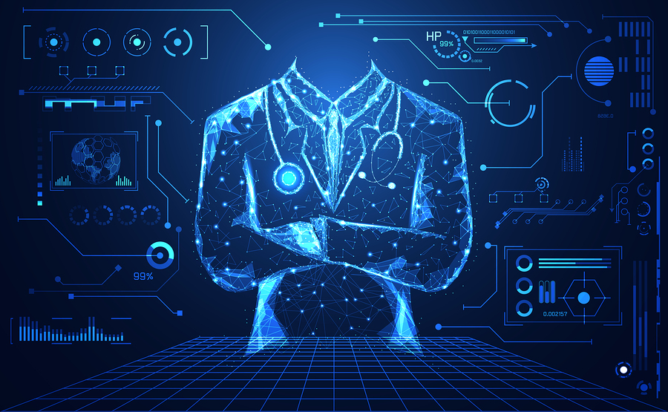
Health and technology
BCI, Bionics, and Nanobots
By: William Howell

Slide 2
Examples of current work within the health theme and my interest.
BCI and bionics – prosthetic arms that give the sense of touch back to the user. Allows people to sense their environment using a system that sends signals back to the brain.
Nanobots – pill bots that can detect and help people with ailments. These capsules can be used to detect and treat ailments by being extremely invasive yet safe.
Notes:
For these products I summed up what they were with two names. BCI and Bionics because the said technology is piggybacking on BCI and bionic research. Nanobots were simple enough as they are small robots that can either be used to detect, diagnose, and medicate patients.

Slide 3
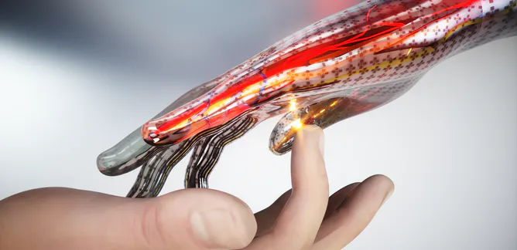
BCI and Bionics – How will it help?
In “Nanorobotic Applications in Medicine: Current Proposals and Designs” they talk about a prosthetic that gave the sense of touch back as well as the ability to use their arm.
This project will allow people with damaged nerves may be able to feel again. This is something that becomes an issue especially for people who might have “Congenital insensitivity to pain.”.
Notes:
In the first bullet the user was able to sense an egg and prevent the robotic arm from squeezing too hard. This is the next step in human and technology integration because we can now receive input like the skin on our hands from technology.
For the second bullet I wanted to add, In other words this means the person affected by this never feels pain. This can be a problem for them because self-mutilation is very common, and this is a problem for anyone with nerve damage because if you can’t feel pain how are you going to stay healthy and get away from danger.

Slide 4
BCI and Bionics – Technical Details
This product is called the LUKE arm developed by DEKA Research & Development Corp. and the arm is made from metal motor parts with silicon “skin” over the hand. This is then wired to a battery and computer.
It works sensors built into the hand that send signals through your nerves. To imitate the grabbing sensation a burst signal will be sent, and it will then taper off to imitate how a signal is received like how we feel it biologically.

Slide 5
BCI and Bionics - Outcomes
After 15 years of development the product was successful and gave the sense of touch back. According to the user it was an emotional time to be able to use two arms to put his wedding ring on once again.
This technology was meant to give people back what they lost in their life. It’s something that has many applications and leads us further into what technology can do for us because the sense of touch has been recreated digitally in a false arm and can probably be implemented into skin.
Other applications of this I would like to see might be on burn patients who lost feeling in parts of their body from burns. Another would be on people afflicted with disease that might alter their sense of touch. This can be a very big quality of life improvement.

Slide 6
BCI and Bionics - Impact
The impact of this technology is very critical in creating a world like how we see in the movies. This can be an economic boost for employment and brings a lot of light to bionics as people who might require two arms and a sense of touch for work might require. This will make it easy for them to go back without too much worry about disability because they have a perfectly capable arm now.
Another impact might be that people will reject the fact that we have recreated a body part and it might be against what they believe to use the product because their culture refutes the idea of using it.
A third impact and perspective on this might be that it will be good for peoples well being. Some people feel secure and whole when they have something in place of a limb they lost and to have something that feels real might be really comforting.
Notes:
The Impact this technology will have is great because people will no longer needs skin graphs because they might be able to get a form of the silicon skin with sensors in it in place.

Slide 7
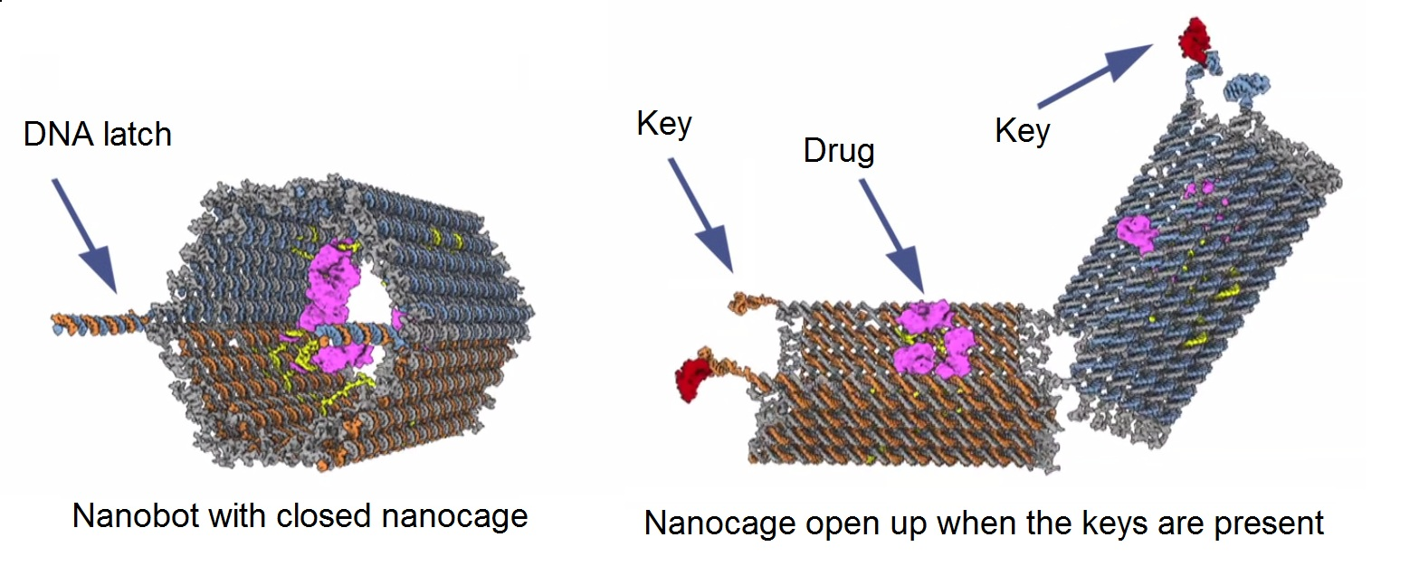
Nanobots – How will it help?
In “Nanobots promise to change the future of medical treatment” we learn about technology that will change how we treat and diagnose patients. This product is in pill form and can be used to help people monitor their personal health.
A few groups working on Nanobots include MIT, researchers at Arizona State University, and the Chinese Academy of Sciences’ National Center for Nanoscience and Technology.
Notes:
I think this technology can be the next step in creating more sustainable lives and helping prolong human life expectancy by being able to detect diseases and ailments before they become too big of an issue. Types of pills that have been theorized are a smart pill that can dose track, vibrate, and detect.

Slide 8
Nanobots – Technical details
Leaving off from last slide. Dose tracking capsules will help people by releasing dosages of medication as prescribed to the patient without having to worry about taking a pill at 10:00. The Vibrating capsule will help people with digestive issues and help treat constipation. The pill that detects is a smart sensor capsule that will track vitals and can also be used to release medications.
These are all ideas that are being theorized and researched. They work through the user digesting the capsule and depending on the type it will act different. They are used in different cases, but all are effective for the use of monitoring and treating patients.

Slide 9
Nanobots – Outcomes
The first product produced by the company was a pill cam that has already been used many times. Other capsules brought up were some that release medication or sense for ailments.
Some draw backs that were listed included that products had to be either listed as a drug or device by law which obstructed production.
Other things that were researched and stemmed from this included cancer fighting robots that can help remove cancerous tissue without harming healthy tissue. This can be a big step in fighting cancer and can lead to many other applications that remove harmful materials from your body.

Slide 10
Nanobots - Impact
Nanobots have a lot of value in todays society as it was something considered sci-fi and cool years ago. People looking at them now are in awe and although some people may prefer the leave life to nature others would like to see what applications are possible with nanobots which might go against someone’s culture.
Big impacts that I see happening soon are the cancer fighting cells coming out to help patients who have cancer to remove it possibly without chemotherapy which will bring a lot of good reputation to the community of science in the medical field because cancer is probably one of the most popular ailments that people know about and to cure with nanobots would be a feat. This could possibly boost economy and bring a lot of big figures in the picture as they might want to endorse the product.
Another perspective on nanobots might also be that some people don’t like them. As brought up in “Nanobots promise to change the future of medical treatment”, people with schizophrenia might be hesitant because of their paranoia and hesitant to allow someone monitor and be inside them. With or without fear of this some people are uncomfortable with the thought of someone monitoring them and this was brought up.
Notes:
Nanobots provide a lot of insight on what might be affecting someone. People might use these as quick ways to check up on themselves instead of a primary physician as they can use sensors to detect anomalies in your health.

Slide 11
Resources
“Open-Source Tools for Neuroscience,” OpenBCI, 27-Aug-2020. [Online]. Available: https://openbci.com/?utm_source=google. [Accessed: 30-Nov-2020].
J. J. Shih, D. J. Krusienski, and J. R. Wolpaw, “Brain-computer interfaces in medicine,” Mayo Clinic proceedings, Mar-2012. [Online]. Available: https://www.ncbi.nlm.nih.gov/pmc/articles/PMC3497935/. [Accessed: 30-Nov-2020].
sciencedaily.com/releases/2019/07/190724144150.htmY. Saadeh and D. Vyas, “Nanorobotic Applications in Medicine: Current Proposals and Designs,” American journal of robotic surgery, Jun-2014. [Online]. Available: https://www.ncbi.nlm.nih.gov/pmc/articles/PMC4562685/. [Accessed: 30-Nov-2020].
T. R. R. Staff, T. R. R. Staff, S. H. I. R. L. E. Y. M. B. U. C. H. A. N. A. N. says, S. M. Buchanan, D. F. says, and DbotFitz, “Nanobots promise to change the future of medical treatment,” The Robot Report, 11-Oct-2019. [Online]. Available: https://www.therobotreport.com/nanobots-promise-change-medical-treatment/. [Accessed: 30-Nov-2020].

